Slide 1
Using Sorbents
CGPRT(W) : Ensuring Clean Seas and Coasts in Western Region ……

Slide 2
Objective
To understand the different types of sorbents and their use.
CGPRT(W) : Ensuring Clean Seas and Coasts in Western Region ……

Slide 3
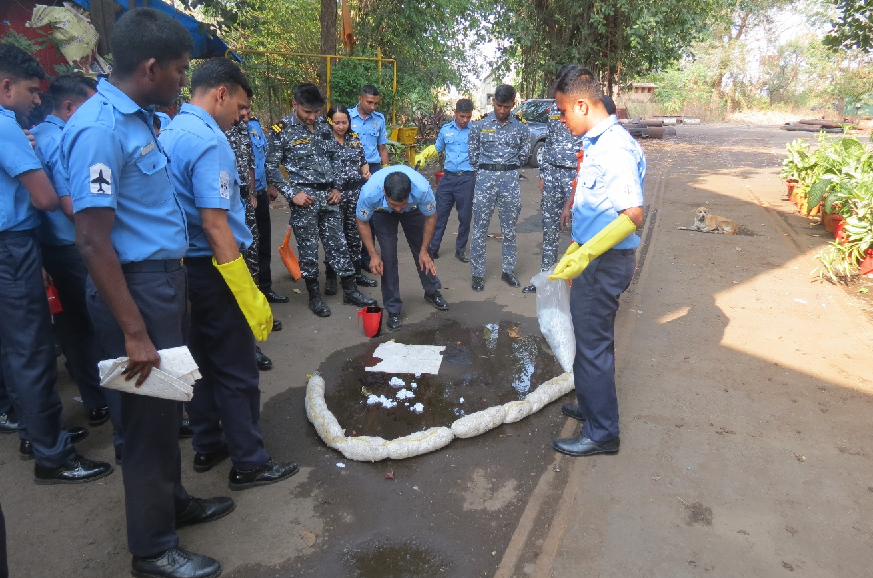
Using Sorbents
Definition
Uses
Types
Forms
Advantages and disadvantages
Considerations
CGPRT(W) : Ensuring Clean Seas and Coasts in Western Region ……

Slide 4
Definitions
Sorbents are products or mixtures of products that are used to collect liquid oil through absorption and/or adsorption.
Absorbents: oil is soaked up and penetrates into the material.
Adsorbents: oil is attracted to and adheres to the surface of the material.
CGPRT(W) : Ensuring Clean Seas and Coasts in Western Region ……

Slide 5
Definitions
To be effective sorbents are :
Oleophilic (attracts oil)
Hydrophobic (repels water)
Do not sink
Easily recoverable
CGPRT(W) : Ensuring Clean Seas and Coasts in Western Region ……

Slide 6
Uses
Small spills
Recover final traces of oil “polishing”
Used to line boom and block any gaps
Used in areas where it is not possible to use a skimmer
CGPRT(W) : Ensuring Clean Seas and Coasts in Western Region ……

Slide 7
Uses
Protect area difficult to clean up
Recover effluents from clean-up operation
Filter oil in water column
Protect circulation path and working area
Clean up and decontaminate workers and equipment
CGPRT(W) : Ensuring Clean Seas and Coasts in Western Region ……

Slide 8
Types
Natural organic
Natural inorganic
Synthetic
CGPRT(W) : Ensuring Clean Seas and Coasts in Western Region ……

Slide 9
Forms
Bulk
Enclosed
Continuous
Fibre
CGPRT(W) : Ensuring Clean Seas and Coasts in Western Region ……

Slide 10
Natural Organic
Peat moss
Straw/hay
Feathers
Corncobs
Sawdust
Wool
Hair
Other carbon based products
CGPRT(W) : Ensuring Clean Seas and Coasts in Western Region ……

Slide 11
Natural Organic
Advantages:
Use what is readily available in large amounts.
Relatively low cost.
Adsorb between 5 to 15 times their weight in oil.
CGPRT(W) : Ensuring Clean Seas and Coasts in Western Region ……

Slide 12
Natural Organic
Disadvantages:
Have a tendency to sink.
Loose materials are difficult to control/recover and need to be contained.
CGPRT(W) : Ensuring Clean Seas and Coasts in Western Region ……

Slide 13
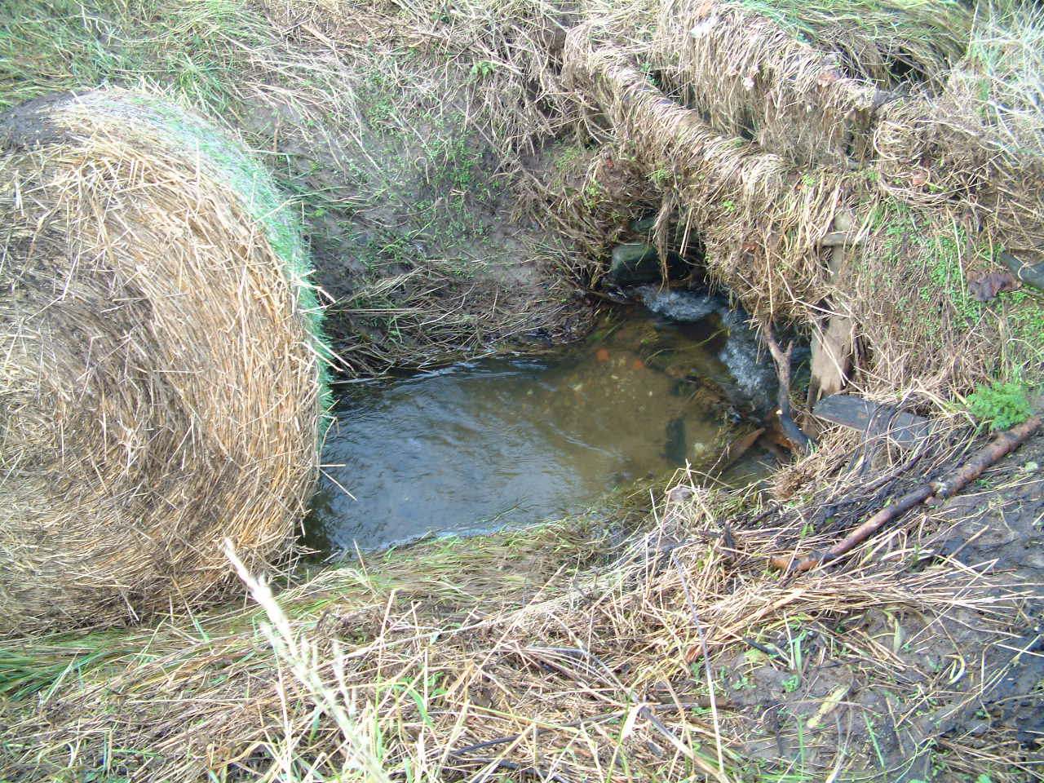

Natural Organic
Straw bales used in a diesel spill
CGPRT(W) : Ensuring Clean Seas and Coasts in Western Region ……

Slide 14
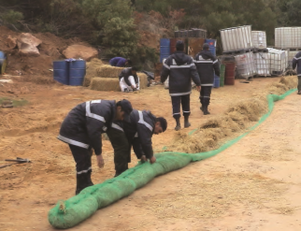
Natural Organic
CGPRT(W) : Ensuring Clean Seas and Coasts in Western Region ……

Slide 15
Natural Inorganic
Vermiculite
Perlite
Clay
Volcanic ash
Sand
Snow
CGPRT(W) : Ensuring Clean Seas and Coasts in Western Region ……

Slide 16
Natural Inorganic
Advantages:
Use what is readily available in large amounts.
Relatively low cost.
Adsorb up to 20 times their weight in oil.
CGPRT(W) : Ensuring Clean Seas and Coasts in Western Region ……

Slide 17
Natural Inorganic
Disadvantages:
Loose materials are difficult to control/recover and need to be contained/not suitable for use on water.
May be difficult to apply.
Non bio-degradable.
Wind can make it difficult to apply.
CGPRT(W) : Ensuring Clean Seas and Coasts in Western Region ……

Slide 18
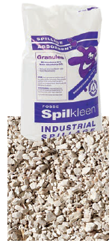
Natural Inorganic
CGPRT(W) : Ensuring Clean Seas and Coasts in Western Region ……

Slide 19
Synthetic
Polyurethane
Polypropylene
Polyethylene
CGPRT(W) : Ensuring Clean Seas and Coasts in Western Region ……

Slide 20
Synthetic
Pads, mats and rolls for various oil types
Sheets
Boom
Pom poms/snares
CGPRT(W) : Ensuring Clean Seas and Coasts in Western Region ……

Slide 21
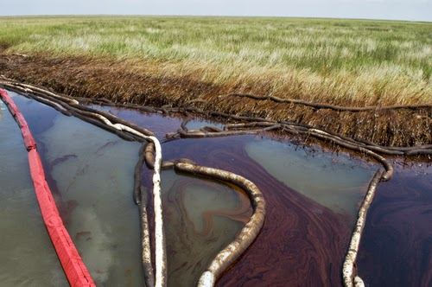
Sorbent Boom
Source: Fosse Liquitrol
Source: USCG
CGPRT(W) : Ensuring Clean Seas and Coasts in Western Region ……

Slide 22
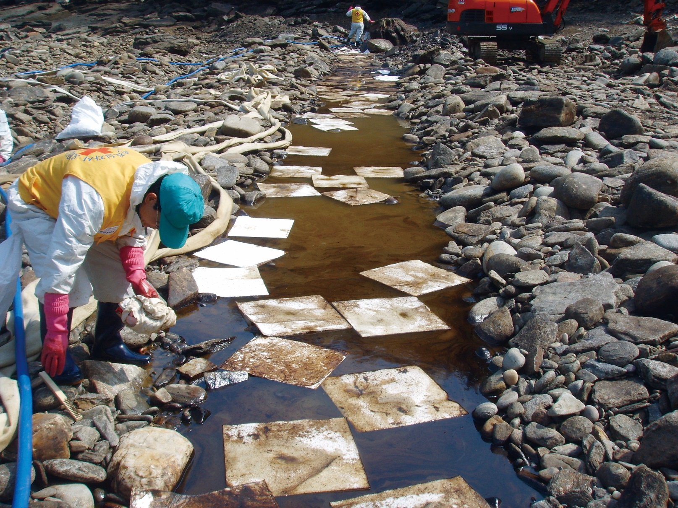
Synthetic Pads
Source: Korea Coast Guard
CGPRT(W) : Ensuring Clean Seas and Coasts in Western Region ……

Slide 23
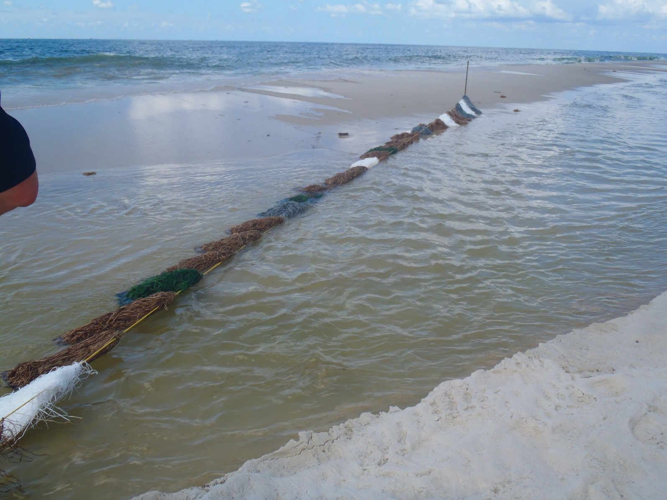
Pom Poms/Snare
Source: OSRL
CGPRT(W) : Ensuring Clean Seas and Coasts in Western Region ……

Slide 24
Synthetic
Advantages:
Good retention capability − can adsorb/absorb up to 40 times their weight in oil
Recover very little water
May be reused
Easy to deploy
CGPRT(W) : Ensuring Clean Seas and Coasts in Western Region ……

Slide 25
Synthetic
Disadvantages:
Can create significant amounts of hazardous waste
Heavy when saturated
Not robust
CGPRT(W) : Ensuring Clean Seas and Coasts in Western Region ……

Slide 26
Considerations
Secondary contamination
Not intended for open sea
Cost
Storage and transportation
CGPRT(W) : Ensuring Clean Seas and Coasts in Western Region ……

Slide 27
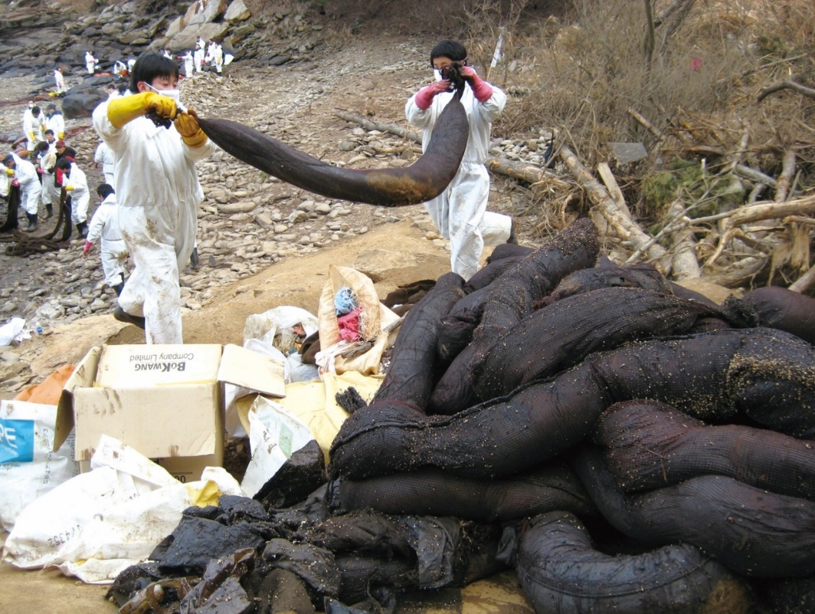
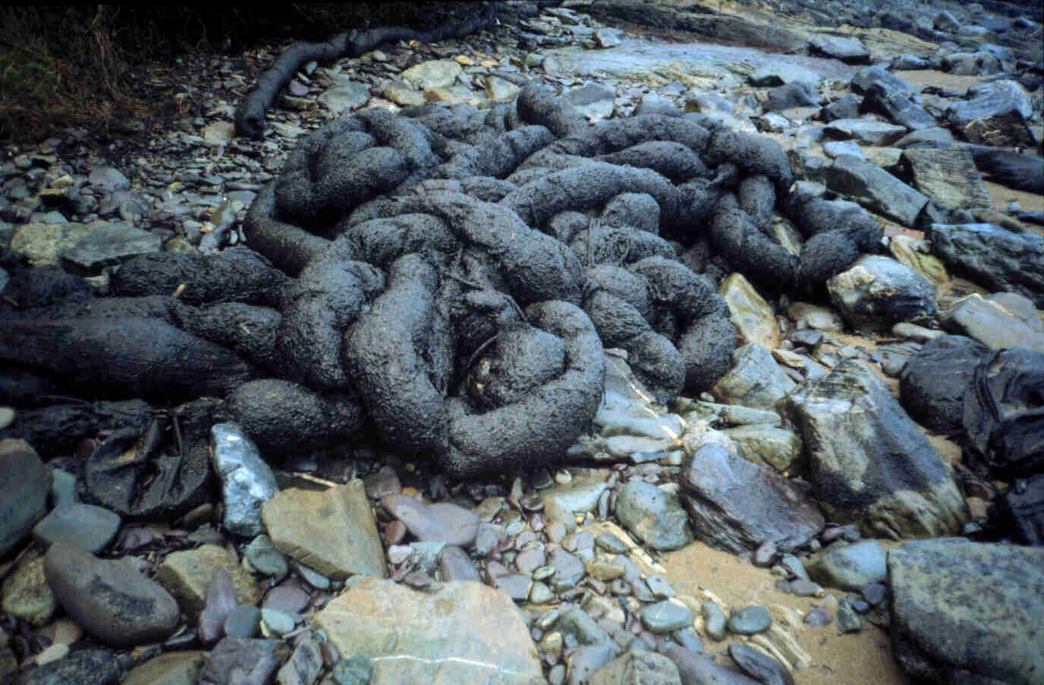
Considerations
Avoid secondary contamination
Source: Korea Coast Guard
CGPRT(W) : Ensuring Clean Seas and Coasts in Western Region ……

Slide 28
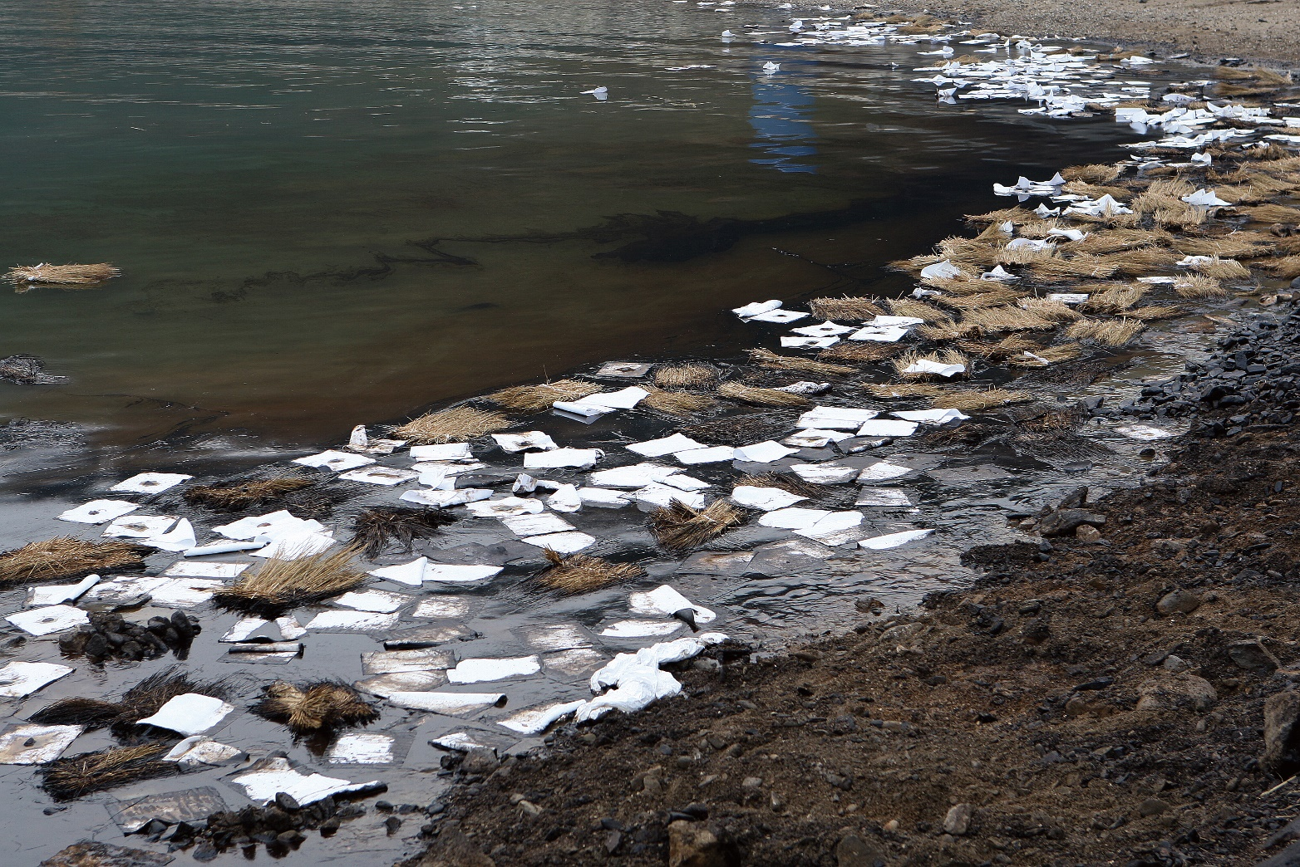
Considerations
Ensure sorbents are contained
Source: Korea Coast Guard
CGPRT(W) : Ensuring Clean Seas and Coasts in Western Region ……

Slide 29
Practical Recommendations
Deploying sorbent boom
deployed by boat or along shoreline
can be joined together with fitted clips
used to line other types of boom
used to close gaps in other types of boom
deployed as containment boom in small, calm areas
Recovering sorbent boom
recover carefully section by section, putting into temporary storage container
CGPRT(W) : Ensuring Clean Seas and Coasts in Western Region ……

Slide 30
Practical Recommendations
Deploying sorbent pads
can deploy by putting directly into floating oil or use as a contact barrier
ensure they are in a contained area to avoid secondary contamination
can be deployed from a boat or from shore
Recovering sorbent pads or rolls
can recover with pitchforks or nets
can collect and put into temporary storage unit
CGPRT(W) : Ensuring Clean Seas and Coasts in Western Region ……

Slide 31
Practical Recommendations
Deploying granular sorbents
ensure they are in a contained area to avoid secondary contamination
apply directly to oil on land/docks
not for use on open water or in high winds
Recovering granular sorbents
recover with shovels, rakes
collect and put into temporary storage unit
CGPRT(W) : Ensuring Clean Seas and Coasts in Western Region ……

Slide 32
Practical Recommendations
Deploying snare/pompom
may be tied in a continuous line/staked in place
Recovering snare/pompom
recover manually
collect on regular basis to prevent from becoming buried by sediment
CGPRT(W) : Ensuring Clean Seas and Coasts in Western Region ……

Slide 33
Health and Safety
Always use proper PPE when deploying or recovering
Avoid contamination contact
Use proper lifting procedures
Be aware of the weight when recovering – saturated sorbents can become heavy
CGPRT(W) : Ensuring Clean Seas and Coasts in Western Region ……

Slide 34
Summary
Use of sorbents can be effective under the proper conditions.
Use of sorbents must be carefully considered and managed to control cost, minimize waste and prevent secondary contamination.
Locally available organic sorbents are typically low cost compared to the more effective synthetic products.
CGPRT(W) : Ensuring Clean Seas and Coasts in Western Region ……

Slide 35
Any questions?
CGPRT(W) : Ensuring Clean Seas and Coasts in Western Region ……

